Slide 1
2CEIT403:
APPLICATION DEVELOPMENT TOOLS
Bhavisha R. Suthar

Slide 2
UNIT-II C# Basics using Console Application

Slide 3
Basics in Programming
System: A System namespace contains fundamental classes and base classes that define commonly-used value and reference data types, events and event handlers, interfaces, attributes, and processing exceptions.

Slide 4
Basics in Programming
Console: Represents the standard input, output, and error streams for console applications. This class cannot be inherited.

Slide 5
Basics in Programming
Static: A static class is basically the same as a non-static class, but there is one difference: a static class cannot be instantiated. In other words, you cannot use the new keyword to create a variable of the class type. Because there is no instance variable, you access the members of a static class by using the class name itself.
example, if you have a static class that is named UtilityClass that has a public method named MethodA,
Code: UtilityClass.MethodA();

Slide 6
Introduction to c#
Pronounced as “ C Sharp”
Developed by Anders Hejlsberg and Team
One of the language designed for CLI
Notes:
C Sharp – The meaning of # notation is used for musical background. # used to represent higher nodes. So it called sharp.
CLI- common language infrastructure. By which C# language compatible with .Net framework

Slide 7
C# (C Sharp)
C# is a modern, general-purpose, object-oriented programming language developed by Microsoft.
Runs on the .NET Framework.
Designed for Common Language Infrastructure (CLI), which consists of the executable code and runtime environment that allows use of various high-level languages on different computer platforms and architectures.
Notes:
Faculty Notes:
C# code is compiled as managed code, which means it benefits from the services of the common language runtime. These services include language interoperability, garbage collection, enhanced security, and improved versioning support.

Slide 8
Why C# widely used as professional language?
It is a modern, general-purpose programming language.
It is object oriented.
It is component oriented.
It is easy to learn.
It is a structured language.
It produces efficient programs.
It can be compiled on a variety of computer platforms.
It is a part of .Net Framework.

Slide 9
C# Programming Features
Simple
Modern programming language
Object oriented
Type safe
Interoperability
Scalable and Updatable
Component oriented
Structured programming language
Rich Library
Fast speed
Secure
Notes:
Faculty Notes:
Simple – It simplifies the use of operators such as -> :: and pointers. It treats integers and boolean data types as two different types.
Modern – because it supports:
Automatic garbage collection
Rich model for Error handling
Decimal Data type for Financial applications
Robust Security model
Object –Oriented:
Supports all the tenets of an object-oriented system
Encapsulation
Inheritance
Polymorphism
Type-Safe:
Dynamically allocated objects and arrays are initialized to zero
Access to arrays are range bound and warned if it goes out of bounds
C# enforces overflow checking in arithmetic operations
Reference parameters that are passed are type-safe
Versionable:
New versions of software's work with existing applications this is known as versioning
Compatible:
Enforces .NET common language specifications and there fore allows inter-operation with other .NET languages

Slide 10
Program Structure
Namespace declaration
A class
Class methods
Class attributes
The Main method
Statements and Expressions
Comments

Slide 11

Sample Program-1
HelloProgram.cs
using System;
namespace HelloProgram
{
class Program
{
static void Main(string[] args)
{
Console.WriteLine("Hello");
Console.ReadKey();
}
}
}
Notes:
The System namespace in the program. A program generally has multiple using statements.
using System used to include the namespace declaration. A namespace is a collection of classes. The HelloProgram namespace contains the class HelloProgram.
Class Program contains the data and methods definitions that your program uses.
Main is the entry point in the program
Console is class is in the System namespace. And WriteLine is method
Console.ReadKey(); This makes the program wait for a key press and it prevents the screen from running and closing quickly when the program is launched from Visual Studio .NET.

Slide 12
Basics
Using System
Namespace
Class
Main(string[] args)
Console
WriteLine
Write
ReadLine() : accept string and return string as well
Read() :accept string but return integer
Readkey() : accept character and return ASCII value of character
Clear() : clear the window

Slide 13


Write() and WriteLine()
using System;
namespace HelloProgram
{
//This is Hello Program
class Program
{
static void Main(string[] args)
{
Console.Write("Hello");
Console.ReadKey();
}
}
}
Console.WriteLine("Hello");

Slide 14
Read(), ReadLine() and ReadKey()
ReadLine() : read all the characters from user input and return string
Read() : accept string but return ASCII value of first character (returns integer value)
Readkey() : accept character and return information about character

Slide 15
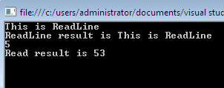
Read() and ReadLine()
using System.Text;
namespace HelloProgram
{
class ReadWrite
{
static void Main(string[] args){
// It will print string
string name = Console.ReadLine();
Console.WriteLine("ReadLine result is {0}", name);
// It will print ascii value of input
int value = Console.Read();
Console.Write("Read result is {0}", value);
Console.ReadKey();
}}}

Slide 16

Read(), ReadLine()
using System;
namespace HelloProgram{
class Read_readline_readkey {
static void Main(){
/** Console.Readline reads the current Line as a string and returns whole string */
Console.Write("Please Enter Something : ");
string str1 = Console.ReadLine();
Console.WriteLine(str1);
/*Consol.Read() reads the First Character of the string or a line and returns ASCII Code*/
/* returns to the code window only after pressing the Enter Key*/
Console.WriteLine("Please Enter Something : ");
int str = Console.Read();
Console.WriteLine(str);
Console.ReadKey();} } }

Slide 17

ReadKey()
using System;
namespace HelloProgram{
class ReadKey {
static void Main(string[] args) {
/* ConsoleReadKey() reads the first character that have entered in the command and returns the keys information like
/* key name , ASCII Code, Which Modifiers(Cntrl,Shift,Alt) are Pressed with the key*/
/* returns to the code window only after pressing any key with modifiers or without modifiers*/
Console.WriteLine("Please Enter some char : ");
ConsoleKeyInfo obj = new ConsoleKeyInfo();
obj = Console.ReadKey();
Console.WriteLine();
Console.WriteLine("Key : {0},KeyChar is :{1},Modifier is :{2}", obj.Key, obj.KeyChar.GetTypeCode(), obj.Modifiers.ToString());
//Here We can use ReadLine(), Read() or ReadKey().
Console.ReadKey();}}}

Slide 18
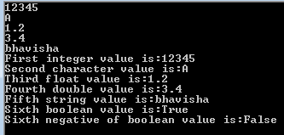
Data types, Input and Output Program
using System;
namespace HelloProgram{
class InputOutPut{
static void Main(string[] args){
//This is program about Reading values and display output on screen.
int a; char b; float c; double d; string e; bool f = true;
//a = int.Parse(Console.ReadLine());
a = Convert.ToInt32(Console.ReadLine()); b = Convert.ToChar(Console.ReadLine());
c = float.Parse(Console.ReadLine()); d = Convert.ToDouble (Console.ReadLine());
e = Console.ReadLine(); //Console.Clear(); // To clear the output window
/* This is the way to print values by index*/
Console.WriteLine("First integer value is:{0}\nSecond character value is:{1}\nThird float value is:{2}\nFourth double value is:{3}\nFifth string value is:{4}", a, b,c, d, e);
Console.Write("Sixth boolean value is:" + f);
Console.WriteLine("Sixth negative of boolean value is:"+!f);
Console.ReadKey(); } } }

Slide 19
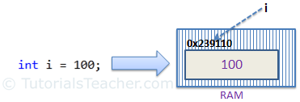
Data Types
Three types:
Value type
Reference type
Pointer type
Value type:
Holds a data value within its own memory space
Variable can assigned value directly.
It is derived from the class System.ValueType

Slide 20
Value type
Variable can assigned value directly.
It is derived from the class System.ValueType
bool | Boolean value
byte | 8-bit unsigned int
Dhar | 16 bit char
Decimal | 128 bit precise decimal value
Double | 64 bit double precision floating number
Float | 32 bit single precision floating
Int | 32 bit signed integer type
Long | 64 bit signed integer type
Sbyte | 8 bit signed int type
Short | 16 bit signed int type
Uint | 32 bit unsigned int type
Ulong | 64 bit unsigned int type
ushort | 16 bit unsigned int type

Slide 21
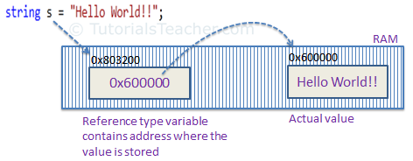
Reference type
It does not contain actual data stored in variable but it contains reference to variable.
It refers memory location
If the data in the memory location is changed by one of the variables, the other variable automatically reflects this change in value.
Three types:
Object type
Dynamic type
String type

Slide 22
Object type
It is base class for all data types
It can assigned values of any other data types.
Type checking for these type of variable takes place at compile time.
Before assigning values, it needs type conversion.

Slide 23
Object type- Boxing and unboxing
Process of converting value type into object type called boxing.
Ex:
int i=100; Object o=i;
Process of converting object type into value type called unboxing.
Ex:
Object o=100; i=(int)o;

Slide 24

Object type
using System;
namespace HelloProgram
{
class ObjectType {
static void Main()
{
object a = 4.5;
object b = 1;
object c = 'A';
object d = "Bhavisha";
int i = 100;
object o = i;
object p = 200;
int j = (int)p;
Console.WriteLine(a);
Console.WriteLine(b);
Console.WriteLine(c);
Console.WriteLine(d);
Console.WriteLine(o);
Console.WriteLine(j);
Console.ReadKey();} } }

Slide 25
Dynamic type
It store any type of value
Type checking for these type of variable takes place at run time.
Ex:
dynamic d=20;

Slide 26

Dynamic type
using System;
namespace HelloProgram
{
class ObjectType
{
static void Main()
{dynamic x = 1;
dynamic q = 1.5;
dynamic r = 'a' ;
dynamic s = "Bhavisha";
Console.WriteLine(x);
Console.WriteLine(q);
Console.WriteLine(r);
Console.WriteLine(s);
Console.ReadKey();
}
}
}

Slide 27
String type
Strings are immutable.
It is derived from object type
Example:
string s = "Hello World!!";

Slide 28
Pointer type
The Pointer Data Types will contain a memory address of the variable value.
ampersand (&): It is Known as Address Operator. It is used to determine the address of a variable.
asterisk (*): It is known as Indirection Operator. It is used to access the value of an address.
Example:
int n = 10; // declare variable
int *p = &n; // store variable n address
Console.WriteLine((int)p); //display memory address
Console.WriteLine(*p); // displays the value at memory address
Notes:
pointers are not as clever, cannot point to anything on the heap, are exempt from garbage collection, and can only reference structs or base types.
C# references can, and will be relocated by garbage collector but normal pointers are static. This is why we use fixed keyword when acquiring a pointer to an array element, to prevent it from getting moved.

Slide 29
Type Casting
Types:
Implicit type casting
Explicit type casting
Notes:
https://docs.microsoft.com/en-us/dotnet/csharp/programming-guide/types/boxing-and-unboxing

Slide 30
Type Casting- Program
Implicit:
int a=42;
float b=a;
Explicit:
float a=42.12;
int b=(int)a;
Notes:
https://docs.microsoft.com/en-us/dotnet/csharp/programming-guide/types/boxing-and-unboxing

Slide 31
Type Casting
using System;
namespace TypeConversionApplication {
class ExplicitConversion {
static void Main(string[] args) {
double d = 5673.74;
int i;
// cast double to int.
i = (int)d;
Console.WriteLine(i);
Console.ReadKey(); } } }
//Output: 5673

Slide 32

Type Casting
using System;
namespace HelloProgram{
class TypeCasting {
static void Main(string[] args) {
double num1 = 1111.74, num2=2222.55;
int i;
// cast double to int.
i = (int)(num1+num2);
Console.WriteLine("sum="+i);
Console.ReadKey();
}}}
Notes:
https://docs.microsoft.com/en-us/dotnet/csharp/programming-guide/types/boxing-and-unboxing

Slide 33
C# type conversion
ToBoolean-Converts a type to a Boolean value, where possible.
ToByte-Converts a type to a byte.
ToChar-Converts a type to a single Unicode character, where possible.
ToDateTime-Converts a type (integer or string type) to date-time structures.
ToDecimal-Converts a floating point or integer type to a decimal type.
ToDouble-Converts a type to a double type.
ToInt16-Converts a type to a 16-bit integer.
ToInt32-Converts a type to a 32-bit integer.
ToInt64-Converts a type to a 64-bit integer.
ToSbyte-Converts a type to a signed byte type.
ToSingle-Converts a type to a small floating point number.
ToString-Converts a type to a string.
ToType-Converts a type to a specified type.
ToUInt16-Converts a type to an unsigned int type.
ToUInt32-Converts a type to an unsigned long type.
ToUInt64-Converts a type to an unsigned big integer.

Slide 34
Nullable type
Nullable types that allow you to assign null to value type variables.
Syntax: Nullable<t>
Example: Nullable<int> i = null;
A nullable type can represent the correct range of values for its underlying value type, plus an additional null value.
E.g. Nullable<int>
range: -2147483648 to 2147483647 or a null value
Example: nullable with HasValue()

Slide 35
Shorthand Syntax for Nullable Types
'?' operator:
e.g. int?, long? instead of using Nullable<T>
Example:
int? i = null;
double? D = null;
?? Operator:
To assign a nullable type to non-nullable type.
Example:
int? i = null;
int j = i ?? 0;

Slide 36

Nullable
using System;
namespace HelloProgram{
class NullableValue{
static void Main(){
string name=null;
int? a = null;
int? b = a;
Console.WriteLine("string value="+name);
Console.WriteLine("B="+b);
a = 10;
b = a ?? 20;
Console.WriteLine("New B="+b);
Console.ReadKey();}}}
Notes:
https://www.tutorialspoint.com/csharp_online_training/c_nullable_type.asp

Slide 37


Nullable Value- Coalescing Operator
using System;
namespace HelloProgram
{
class NullableValue {
static void Main(){
int? a = null;
int? b = a;
Console.WriteLine(b);
//a = 10;
b = a ?? 20; // Coalescing operator
Console.WriteLine(b);
Console.ReadKey();}}}
using System;
namespace HelloProgram
{
class NullableValue {
static void Main(){
string name = null;
int? a = null;
int? b = a;
Console.WriteLine(b);
a = 10;
b = a ?? 20;
Console.WriteLine(b);
Console.ReadKey();}}}
Notes:
https://www.tutorialspoint.com/csharp/csharp_nullables.htm

Slide 38
Operators
Arithmetic Operators
Relational Operators
Logical Operators
Bitwise Operators
Assignment Operators
Misc Operators

Slide 39
Arithmetic Operators
Operator | Description | Example
+ | Adds two operands | A + B = 30
- | Subtracts second operand from the first | A - B = -10
* | Multiplies both operands | A * B = 200
/ | Divides numerator by de-numerator | B / A = 2
% | Modulus Operator and remainder of after an integer division | B % A = 0

Slide 40
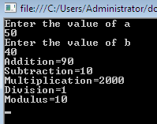

Arithmetic- Program
using System;
namespace HelloProgram{
class ArithmeticOperator{
static void Main(){
int a, b;
Console.WriteLine("Enter the value of a");
a = Convert.ToInt32(Console.ReadLine());
Console.WriteLine("Enter the value of b");
b = Convert.ToInt32(Console.ReadLine());
Console.WriteLine("Addition="+(a + b));
Console.WriteLine("Subtraction={0}\nMultiplication={1}\nDivision={2}\nModulus={3}",(a-b),(a*b),(a/b),(a%b));
Console.ReadKey(); } } }
int marks = 72, max = 80;
int percentage= marks * 100/max; // left to right
Console.WriteLine("Percentage="+ percentage);

Slide 41
Relational Operators
Operator | Description | Example
== | Checks if the values of two operands are equal or not, if yes then condition becomes true. | (A == B) is not true.
!= | Checks if the values of two operands are equal or not, if values are not equal then condition becomes true. | (A != B) is true.
> | Checks if the value of left operand is greater than the value of right operand, if yes then condition becomes true. | (A > B) is not true.
< | Checks if the value of left operand is less than the value of right operand, if yes then condition becomes true. | (A < B) is true.
>= | Checks if the value of left operand is greater than or equal to the value of right operand, if yes then condition becomes true. | (A >= B) is not true.
<= | Checks if the value of left operand is less than or equal to the value of right operand, if yes then condition becomes true. | (A <= B) is true.

Slide 42
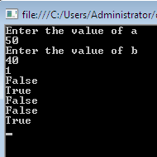
Relational-Program
using System;
namespace HelloProgram {
class RelationalOperator {
static void Main() {
int a, b;
Console.WriteLine("Enter the value of a");
a = Convert.ToInt32(Console.ReadLine());
Console.WriteLine("Enter the value of b");
b = Convert.ToInt32(Console.ReadLine());
Console.WriteLine(Convert.ToInt32(a > b));
Console.WriteLine(a < b);
Console.WriteLine(a >= b);
Console.WriteLine(a <= b);
Console.WriteLine(a == b);
Console.WriteLine(a != b);
Console.ReadKey();}}}

Slide 43
Logical Operators
Operator | Description | Example
&& | Called Logical AND operator. If both the operands are non zero then condition becomes true. | (A && B) is false.
|| | Called Logical OR Operator. If any of the two operands is non zero then condition becomes true. | (A || B) is true.
! | Called Logical NOT Operator. Use to reverses the logical state of its operand. If a condition is true then Logical NOT operator will make false. | !(A && B) is true.

Slide 44
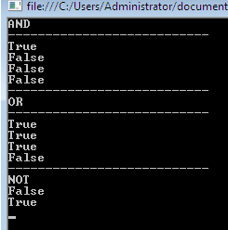
Logical-Program-1
using System;
namespace HelloProgram {
class LogicalOperator {
static void Main(){
Console.WriteLine("AND");
Console.WriteLine("---------------------------");
Console.WriteLine(true && true);
Console.WriteLine(true && false);
Console.WriteLine(false && true);
Console.WriteLine(false && false);
Console.WriteLine("---------------------------");
Console.WriteLine("OR");
Console.WriteLine("---------------------------");
Console.WriteLine(true || true);
Console.WriteLine(true || false);
Console.WriteLine(false || true);
Console.WriteLine(false || false);
Console.WriteLine("---------------------------");
Console.WriteLine("NOT");
Console.WriteLine(!(true));
Console.WriteLine(!(false));
Console.ReadKey(); } } }

Slide 45
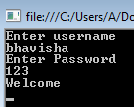
Logical & Conditional Operator-Program-2
using System;
namespace HelloProgram {
class LogicalOperator_2 {
static void Main() {
string username;
Console.WriteLine("Enter username");
username = Console.ReadLine();
int password;
Console.WriteLine("Enter Password");
password = Convert.ToInt32(Console.ReadLine());
string valid = (username == "bhavisha" && password == 123) ? "Welcome" : "Incorrect Username or Password";
Console.WriteLine(valid);
Console.ReadKey(); }}}

Slide 46
Bitwise Operators (A=60, B=13)
Operator | Description | Example
& | Binary AND Operator copies a bit to the result if it exists in both operands. | (A & B) = 12, which is 0000 1100
| | Binary OR Operator copies a bit if it exists in either operand. | (A | B) = 61, which is 0011 1101
^ | Binary XOR Operator copies the bit if it is set in one operand but not both. | (A ^ B) = 49, which is 0011 0001
~ | Binary Ones Complement Operator is unary and has the effect of 'flipping' bits. | (~A ) = 61, which is 1100 0011 in 2's complement due to a signed binary number.
<< | Binary Left Shift Operator. The left operands value is moved left by the number of bits specified by the right operand. | A << 2 = 240, which is 1111 0000
>> | Binary Right Shift Operator. The left operands value is moved right by the number of bits specified by the right operand. | A >> 2 = 15, which is 0000 1111

Slide 47
Bitwise Operators
p | q | p & q | p | q | p
0 | 0 | 0 | 0 | 0
0 | 1 | 0 | 1 | 0
1 | 1 | 1 | 1 | 1
1 | 0 | 0 | 1 | 1

Slide 48

Bitwise-Program
using System;
namespace HelloProgram{
class BitwiseOperator{
static void Main(){
int a = 60; /* 60 = 0011 1100 */
int b = 13; /* 13 = 0000 1101 */ int c = 0;
c = a & b; /* 12 = 0000 1100 */ Console.WriteLine("Bitwise AND : {0}", c);
c = a | b; /* 61 = 0011 1101 */ Console.WriteLine("Bitwise OR : {0}", c);
c = a ^ b; * 49 = 0011 0001 */ Console.WriteLine("Bitwise X-OR : {0}", c);
c = ~a; /*-61 = 1100 0011 */ Console.WriteLine("Complement : {0}", c);
c = a << 2; /* 240 = 1111 0000 */ Console.WriteLine("Shift Left : {0}", c);
c = a >> 2; /* 15 = 0000 1111 */ Console.WriteLine("Shift Right :{0} ", c);
Console.ReadKey(); } } }

Slide 49

Conditional-Program
using System;
namespace HelloProgram{
class ConditionalOperator{
static void Main()
{
int num = 12;
string d=num %2==0? "Even" : "Odd";
Console.WriteLine("Number is: {0}",d);
Console.ReadKey();
} } }

Slide 50
Assignment Operators
Operator | Description | Example
= | Simple assignment operator, Assigns values from right side operands to left side operand | C = A + B assigns value of A + B into C
+= | Add AND assignment operator, It adds right operand to the left operand and assign the result to left operand | C += A is equivalent to C = C + A
-= | Subtract AND assignment operator, It subtracts right operand from the left operand and assign the result to left operand | C -= A is equivalent to C = C - A
*= | Multiply AND assignment operator, It multiplies right operand with the left operand and assign the result to left operand | C *= A is equivalent to C = C * A
/= | Divide AND assignment operator, It divides left operand with the right operand and assign the result to left operand | C /= A is equivalent to C = C / A
%= | Modulus AND assignment operator, It takes modulus using two operands and assign the result to left operand | C %= A is equivalent to C = C % A
<<= | Left shift AND assignment operator | C <<= 2 is same as C = C << 2
>>= | Right shift AND assignment operator | C >>= 2 is same as C = C >> 2
&= | Bitwise AND assignment operator | C &= 2 is same as C = C & 2
^= | bitwise exclusive OR and assignment operator | C ^= 2 is same as C = C ^ 2
|= | bitwise inclusive OR and assignment operator | C |= 2 is same as C = C | 2

Slide 51
Miscellaneous Operators
Operator | Description | Example
sizeof() | Returns the size of a data type. | sizeof(int), returns 4.
typeof() | Returns the type of a class. | typeof(StreamReader);
& | Returns the address of an variable. | &a; returns actual address of the variable.
* | Pointer to a variable. | *a; creates pointer named 'a' to a variable.
? : | Conditional Expression | If Condition is true ? Then value X : Otherwise value Y
is | Determines whether an object is of a certain type. | If( Ford is Car) // checks if Ford is an object of the Car class.
as | Cast without raising an exception if the cast fails. | Object obj = new StringReader("Hello"); StringReader r = obj as StringReader;

Slide 52
Is Operator
The "is" operator is used to check whether the run-time type of an object is compatible with a given type or not.
It returns bool value true: if object is same type
It returns bool value false: if object is not of same type
Syntax: bool variable_name = object_name is type
Notes:
http://www.c-sharpcorner.com/uploadfile/abhikumarvatsa/the-is-and-as-operators-in-C-Sharp/

Slide 53

Is Operator- Program1
using System;
namespace HelloProgram {
class IsOperator {
static void Main() {
object str1 = "Hello";
//if (str1 is int)
if (str1 is string)
Console.WriteLine("This is same Type");
else
Console.WriteLine("This is not same Type");
Console.ReadKey();
} } }

Slide 54

Is Operator- Program2
using System;
namespace HelloProgram{
class IsOperator2{
public static void Main(){
Class1 c1 = new Class1();
Class2 c2 = new Class2();
IsTest.Test(c1);
IsTest.Test(c2);
IsTest.Test("Passing String Value instead of class");
Console.ReadKey(); } }
class Class1
{
}
class Class2
{
}
public class IsTest
{
public static void Test(object o)
{
Class1 a;
Class2 b;
if (o is Class1)
{
Console.WriteLine("o is Class1");
a = (Class1)o;
}
else if (o is Class2)
{
Console.WriteLine("o is Class2");
b = (Class2)o;
}
else
{
Console.WriteLine("o is neither Class1 nor Class2.");
}
}
}
}

Slide 55
As Operator
“Casting Type”
Perform conversions between compatible types.
It converts reference type explicitly into specific type.
If reference type is compatible with specified type, it performs successful conversion.
Otherwise, It returns null value.
NOTE: It does not throw exception.
Syntax: Type variable_name = object_name as type
Notes:
http://www.c-sharpcorner.com/uploadfile/abhikumarvatsa/the-is-and-as-operators-in-C-Sharp/

Slide 56
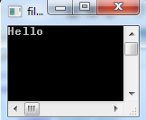
As Operator
using System;
namespace HelloProgram{
class AsOperator{
static void Main()
{
object i = 25;
object str = "Hello";
string str1 = i as string;
string str2 = str as string;
Console.Write(str1); // null
Console.Write(str2); // Hello
Console.ReadKey();
}
} }

Slide 57
Advantage of ‘as’ over ‘is’
In ‘is’ operator to type cast we need to
Check the type using ‘is’
If it is true then type cast
It affect the performance
To avoid : use ‘as’ operator
- It will do it in one step only.
Notes:
http://www.c-sharpcorner.com/uploadfile/abhikumarvatsa/the-is-and-as-operators-in-C-Sharp/

Slide 58
Control Statements
Controls the flow of execution
Enable stratements to be executed on specific condition
Enable statements to be executed repeatedly
Enable to jump on a particular point in the code

Slide 59
Control Statements
Can be classified in:
Conditional statements
Iteration Statements/ Loops
Jump Statements[e.g. goto, break, continue]

Slide 60

If Else Statements
using System;
namespace HelloProgram{
class IfElse {
static void Main() {
Console.WriteLine("Enter number");
int num = int.Parse(Console.ReadLine());
if (num % 2 == 0)
{
Console.WriteLine("Even number");
}
else
{
Console.WriteLine("Odd number");
}
Console.ReadKey();
}
}
}

Slide 61

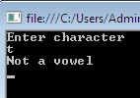
Switch Statement
using System;
namespace HelloProgram{
class Switch{
static void Main(){
Console.WriteLine("Enter character");
char ch = char.Parse(Console.ReadLine());
string s = ch.ToString().ToLower();
switch (s) {
case "a":
Console.WriteLine("a is vowel"); break;
case "e":
Console.WriteLine("e is vowel“); break;
case "i":
Console.WriteLine("i is vowel"); break;
case "o":
Console.WriteLine("o is vowel"); break;
case "u":
Console.WriteLine("u is vowel"); break;
default:
Console.WriteLine("Not a vowel“); break; }
Console.ReadKey();}}}

Slide 62
Loop/ Iteration Statement
Can be classified into:
For loop
While loop
Do…while loop
Foreach loop

Slide 63

For Loop
using System;
namespace HelloProgram
{
class ForLoop
{
static void Main()
{
for (int i = 0; i < 10; i++)
{
Console.WriteLine(i);
}
Console.ReadKey();
}
}
}

Slide 64
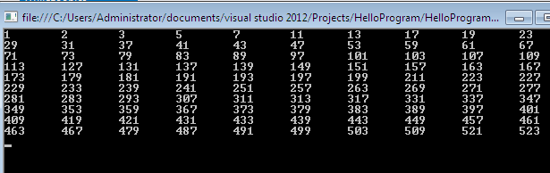
While Loop
using System;
namespace HelloProgram {
class WhileLoop {
static void Main() {
bool isprime = true;
int count = 0;
int num = 1;
while (count < 100) {
isprime = true;
for (int i = 2; i <=Math.Sqrt(num); i++) {
if (num % i == 0) {
isprime = false;
break; } }
if (isprime) {
Console.Write(num+"\t");
count++; }
num++; }
Console.ReadKey(); } } }

Slide 65

Do…While Loop
using System;
namespace HelloProgram {
class DoWhileLoop {
static void Main() {
string name = "bhavisha";
string pin = "9876";
int count = 0;
string num;
do
{
num = Console.ReadLine();
count++;
} while (num != pin && count < 3);
if (num == pin){
Console.WriteLine("Welcome {0}",name);}
else {
Console.WriteLine("Account Locked");}
Console.ReadKey(); } } }

Slide 66
Jump Statement
Goto statement
Break statement
Continue statement

Slide 67

Goto Statement
using System;
namespace HelloProgram
{
class Goto
{
static void Main()
{
int i = 1;
up:
Console.WriteLine(i);
i++;
if (i <= 10)
goto up;
Console.ReadKey(); } } }

Slide 68
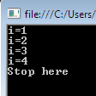
Break Statement
using System;
namespace HelloProgram
{
class Break
{
static void Main()
{
for (int i = 1; i <= 10; i++)
{
if (i == 5)
break;
Console.WriteLine("i="+i);
}
Console.WriteLine("Stop here");
Console.ReadKey(); } } }

Slide 69

Continue Statement
using System;
namespace HelloProgram
{
class Continue
{
static void Main()
{
for (int i = 1; i <= 10; i++)
{
if (i == 5)
continue;
Console.WriteLine("i=" + i);
}
Console.ReadKey(); } } }

Slide 70
Foreach loop
It executes a block of code on each element in an array.
The foreach loop is useful for traversing each item in an array or a collection of items and displayed one by one.

Slide 71
Foreach loop
In foreach loop the variable of the loop will be same as the type of values under the array.
The foreach statement repeats a group of embedded statements for each element in an array or an object collection.
In foreach loop, You do not need to specify the loop bounds minimum or maximum.
Syntax:
foreach (data_type var_name in collection_variable) { // statments }

Slide 72
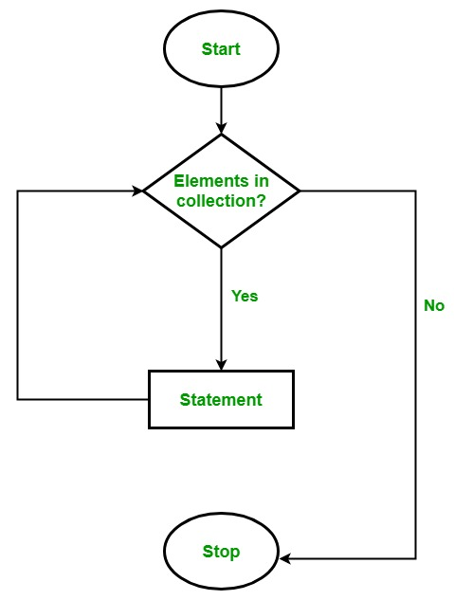
Foreach loop
Flowchart of foreach loop

Slide 73
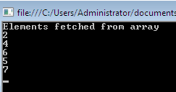
Foreach loop Program
using System;
namespace HelloProgram
{
class ForeachLoop
{
static void Main()
{
int[] arr = new int[] { 2,4,6,5,7};
Console.WriteLine("Elements fetched from array");
foreach (int item in arr)
{
Console.WriteLine(item);
}
Console.ReadKey();
}
}
}

Slide 74
Difference between for loop and foreach loop
for loop executes a statement or a block of statement until the given condition is false. Whereas foreach loop executes a statement or a block of statements for each element present in the array and there is no need to define the minimum or maximum limit.
In for loop, we iterate the array in both forward and backward directions, e.g from index 0 to 9 and from index 9 to 0. But in the foreach loop, we iterate an array only in the forward direction, not in a backward direction.

Slide 75
Array
It is used to store collection of data
Store a fixed size sequential collection of element of same data type.
Instead of declaring individual variable, you declare one array.
Array elements are accessed by its index.
Types of array:
Single Dimensional Array
Multi Dimensional Array
Jagged Array

Slide 76
1-dim array
Int[] arr1= new int[5];
arr1[0]=10;
arr1[1]=20;
arr1[2]=30;
Int[] arr2= new int[5] {1,2,3,4,5};
Int[] arr3= new int[] {1,2,3,4,5};

Slide 77
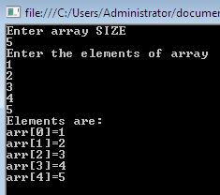
1-dim array-Program
using System;
namespace HelloProgram {
class Array1 {
static void Main() {
Console.WriteLine("Enter array SIZE");
int n=Convert.ToInt32(Console.ReadLine());
int[] arr = new int[n];
Console.WriteLine("Enter the elements of array");
for (int i = 0; i < n; i++)
{
arr[i] = Convert.ToInt32(Console.ReadLine());
}
Console.WriteLine("Elements are:");
for(int i=0;i<n;i++)
{
Console.WriteLine("arr[{0}]={1}",i,arr[i]);
}
Console.ReadKey(); } } }

Slide 78
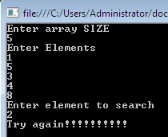
1-dim array-Program (Search)
using System;
namespace HelloProgram {
class Array1_Search {
static void Main() {
bool found = false;
Console.WriteLine("Enter array SIZE");
int total = int.Parse(Console.ReadLine());
Console.WriteLine("Enter Elements");
int[] arr=new int[total];
for (int i = 0; i < total; i++)
{
arr[i] = Convert.ToInt32(Console.ReadLine());
}
Console.WriteLine("Enter element to search");
int num = int.Parse(Console.ReadLine());
for (int i = 0 ; i <arr.Length; i++)
{
if (num == arr[i]) { found = true; break; }
}
if (found) { Console.WriteLine("Element found"); }
else { Console.WriteLine("Try again!!!!!!!!!!"); }
Console.ReadKey(); } } }

Slide 79
2-dim array
int[,] array2D = new int[,] { { 1, 2 }, { 3, 4 }, { 5, 6 }, { 7, 8 } };
int[,] array2Da = new int[4, 2] { { 1, 2 }, { 3, 4 }, { 5, 6 }, { 7, 8 } };
string[,] array2Db = new string[3, 2] { { "one", "two" }, { "three", "four" }, { "five", "six" } };

Slide 80
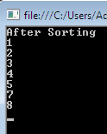
2-dim program (Sorting)
using System;
namespace HelloProgram {
class Array2 {
static void Main() {
int[] arr = new int[] { 7, 4, 3, 5, 8, 1, 2 };
int temp;
for (int i = 0; i < arr.Length; i++)
{
for (int j = 0; j < arr.Length - 1; j++)
{
if (arr[j] > arr[j + 1])
{
temp = arr[j];
arr[j] = arr[j+1];
arr[j+1] = temp; } } }
Console.WriteLine("After Sorting");
foreach (int item in arr)
{
Console.WriteLine(item);
}
Console.ReadKey(); } } }

Slide 81
2 dim-Program (Matrix multiplication)
using System;
namespace ConsoleApplication2_5
{
class Program
{
static void Main(string[] args)
{
int i, j;
Console.WriteLine("Enter 1st matrix rows & columns");
int m=Convert.ToInt32(Console.ReadLine());
int n = Convert.ToInt32(Console.ReadLine());
Console.WriteLine("Enter 2nd matrix columns");
int o = Convert.ToInt32(Console.ReadLine());
int[,] a= new int[m,n];
int[,] b = new int[n,o];
Console.WriteLine("Enter 1st matrix elements");
for (i = 0; i < m; i++)
{for (j = 0; j < n; j++)
{a[i, j] = Convert.ToInt32(Console.ReadLine());}}
Console.WriteLine("1st matrix");
for (i = 0; i < m; i++){
for (j = 0; j < n; j++){
Console.Write(a[i, j] + "\t");}
Console.WriteLine();}
Console.WriteLine("Enter 2nd matrix elements");
for (i = 0; i < n; i++){
for (j = 0; j < o; j++){
b[i, j] = Convert.ToInt32(Console.ReadLine());}}
Console.WriteLine("2nd matrix");
for (i = 0; i < n; i++){
for (j = 0; j < o; j++){
Console.Write(b[i, j] + "\t");}
Console.WriteLine();}
Console.WriteLine("Matrix multiplication is:");
int[,] c = new int[m,o];
for (i = 0; i < m; i++){
for (j = 0; j < o; j++){
c[i, j] = 0;
for (int k = 0; k < n; k++){
c[i, j] += a[i, k] * b[k, j];}}}
for (i = 0; i < m; i++){
for (j = 0; j < o; j++){
Console.Write(c[i, j] + "\t");}
Console.WriteLine();}
Console.ReadKey();}}}

Slide 82
2 dim-Program (Matrix multiplication)

Slide 83
Multi Dimensional array
It is also known as rectangular arrays in C#.
It can be two dimensional or three dimensional.
The data is stored in tabular form (row * column) which is also known as matrix.
Syntax to declare Multi Dimensional array:
To create multidimensional array, use comma inside the square brackets.
int[,] arr=new int[3,3]; //declaration of 2D array
int[,,] arr=new int[3,3,3]; //declaration of 3D array

Slide 84
Multi Dimensional array
More syntax:
int[,] array2D = new int[,] { { 1, 2 }, { 3, 4 }, { 5, 6 }, { 7, 8 } };
int[,] array2Da = new int[4, 2] { { 1, 2 }, { 3, 4 }, { 5, 6 }, { 7, 8 } };
string[,] array2Db = new string[3, 2] { { "one", "two" }, { "three", "four" }, { "five", "six" } };
int[,,] array3D = new int[1,2,3] { { {1, 2 ,3}, { 4, 5, 6 } } };
Program1: Let elements from user and display
Program 2: Addition of two matrix

Slide 85
Array Helper Class
Properties of Array class:
IsFixedSize: get value indicating whether the array has fixed size
Length: Total number of elements in all the dimensions of the Array.
Rank: Get the dimensions of the array

Slide 86
Jagged Array
It is an array whose elements are arrays.
The elements of a jagged array can be of different dimensions and sizes.
A jagged array is sometimes called an "array of arrays."
A special type of array is introduced in C#.
A Jagged Array is an array of an array in which the length of each array index can differ.
Notes:
http://www.c-sharpcorner.com/uploadfile/puranindia/jagged-arrays-in-C-Sharp-net/

Slide 87
Jagged Array-Example
int[][] jaggedArray = new int[3][];
jaggedArray[0] = new int[3];
jaggedArray[1] = new int[5];
jaggedArray[2] = new int[2];
jaggedArray[0] = new int[] { 3, 5, 7 };
jaggedArray[1] = new int[] { 1, 0, 2, 4, 6 };
jaggedArray[2] = new int[] { 1, 6 };
Notes:
http://www.c-sharpcorner.com/uploadfile/puranindia/jagged-arrays-in-C-Sharp-net/http://www.c-sharpcorner.com/uploadfile/puranindia/jagged-arrays-in-C-Sharp-net/

Slide 88
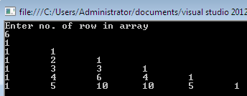
Jagged Array-Program
using System;
namespace HelloProgram {
class JaggedArray {
static void Main() {
int i, j, n;
Console.WriteLine("Enter no. of row in array");
n =Convert.ToInt32(Console.ReadLine());
int[][] a = new int[n][];
for (i = 0; i < n; i++)
{
a[i] = new int[i + 1];
}
a[0][0] = 1;
a[1][0] = 1;
a[1][1] = 1;
for (i = 2; i < n; i++)
{
a[i][0] = a[i][i] = 1;
for (j = 1; j < i; j++) {
a[i][j] = a[i - 1][j - 1] + a[i - 1][j];
} }
for (i = 0; i < n; i++) {
for (j = 0; j <= i; j++) {
Console.Write(a[i][j] + "\t"); }
Console.WriteLine();
}
Console.ReadKey(); } } }

Slide 89
Array Helper Class-Assignment
Write a program about following topics:
Clear
Copy(Array, Array,Int32)
CopyTo(Array, Int32)
GetLength
GetLongLength
GetLowerBound
GetUpperBound
GetType
GetValue(Int32)
IndexOf(Array, Object)
Reverse(Array)
SetValue(Object, Int32)
Sort(Array)
ToString

Slide 90
Function
It is a group of statements to perform a task.
Syntax:
<Access Specifier> <Return Type> Function Name (Parameters)
{
//function body with return statement
}
A function consists of the following components:
Function name: It is unique name which is used to call function.
Return type: It is used to specify the data type of function return value.
Body: It is a block that contains executable statements.
Access specifier: It is used to specify function accessibility in the application.
Parameters: It is a list of arguments can pass to function during call.
Note: Access-specifier, parameters and return statement are optional.

Slide 91

Function
using System;
namespace HelloProgram
{
class Function
{
static void Main()
{
Console.WriteLine("Program started from here:");
functioncall();
Console.WriteLine("Program completes here:");
Console.ReadKey();
}
static void functioncall()
{
Console.WriteLine("Function implemented here");
}
}
}

Slide 92

Array As Function Argument
using System;
namespace HelloProgram {
class ArrayAsFunctionArgument {
static void Main(string[] args) {
int[] arr = { 1, 2, 3, 4, 5 };
PrintArray(arr);
Console.ReadKey();}
static void PrintArray(int[] array)
{
for (int i = 0; i < array.Length; i++)
{
array[i] = array[i] + 1;
Console.WriteLine("The value at index{0} is {1}", i, array[i]); } } } }

Slide 93
“Params” Keyword
In simple function we can allow fixed number of function arguments
Program:
class Program
{
static void Main(string[] args)
{
int y = Add (12,14,43);
}
public static int Add(int num1, int num2, int num3)
{
return num1+num2+num3;
}
}
But in this simple program1 we want to add more parameter run time the use “params keyword”
Unknown parameter passing to array

Slide 94

“Params” Keyword-Program1
_{using System;}
_{namespace HelloProgram {}
_{class ParamKeyword {}
//******Usig Param keyword*****
static void Main(string[] args)
{
int y = Add(12, 14, 43, 34, 56, 100);
Console.WriteLine("Sum=" + y);
Console.ReadKey();
}
public static int Add(params int[] ListNumbers)
{
int total = 0;
foreach (int i in ListNumbers)
{
total = i + total;
}
return total;
} } }
Notes:
In normal function we can allow fixed number of function arguments like “Int Add(int x,int y ) { Return x+y; }”
But what if number of augments are not fixed we want that user allowed to pass as much arguments he want to entered are allowed . In this case the parameter arrays comes in handy.
We can define param array in Function argument by keyword "params" followed by <type name> and then array name.

Slide 95

“Params” Keyword- Program2
using System;
namespace HelloProgram
{
class ParamKeyword
{
static int Add(params int[] nums)
{
int total=0;
foreach(int i in nums)
{
total = total+i;
}
return total;
}
static void Main(string[] args)
{
Console.WriteLine("Parameter Array Function Testing ...");
int result = 0;
result = Add(10, 10, 10);
Console.WriteLine("Result for 3 Prameter :{0}", result);
result = Add(10, 10, 10, 10);
Console.WriteLine("Result for 4 Prameter :{0}", result);
result = Add(10, 10, 10, 10, 10);
Console.WriteLine("Result for 5 Prameter :{0}", result);
int[] x = { 10, 10, 10, 10, 10, 10, 10, 10 };
result = Add(x);
Console.WriteLine("Result for Array Summation Parameter :{0}", result);
Console.ReadKey(); } } }
Notes:
In normal function we can allow fixed number of function arguments like “Int Add(int x,int y ) { Return x+y; }”
But what if number of augments are not fixed we want that user allowed to pass as much arguments he want to entered are allowed . In this case the parameter arrays comes in handy.
We can define param array in Function argument by keyword "params" followed by <type name> and then array name.
http://www.c-sharpcorner.com/UploadFile/c63ec5/use-params-keyword-in-C-Sharp/

Slide 96
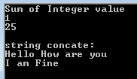
“Params” Keyword- Program2
using System;
namespace HelloProgram{
class Paramkeyword2 {
static void Main() {
Console.WriteLine("integer value sum");
ADDparameters(1);
ADDparameters(1,3,5,7,9,0);
Console.WriteLine("string concate:");
ADDparameters1("Hello", " ", "How", " ", "are", " ", "you");
ADDparameters1("I"," ","am"," ","Fine");
Console.ReadKey();
}
public static void ADDparameters(params int[] arguments) {
int add = 0;
foreach (int arg in arguments)
{
add += arg;
}
Console.WriteLine(add);
}
public static void ADDparameters1(params string[] arguments) {
string add = "";
foreach (string arg in arguments)
{
add += arg;
}
Console.WriteLine(add); } } }

Slide 97
“Params” Keyword- Program3
using System;
namespace HelloProgram {
class Paramkeyword3{
static void Main() {
Console.WriteLine("No parameter");
Useparams();
Console.WriteLine("\nlist of same type arguments comma seperated:");
Useparams(10, 20, 30, 40, 50);
Console.WriteLine("\nDifferent typs of arguments:");
UseParams2(1, 'a', "Hello");
Console.WriteLine("\nInteger array: ");
int[] myIntArray = { 12, 13, 14, 15, 16 };
Useparams(myIntArray);
Console.WriteLine();
Console.WriteLine("\narray with different types of arguments");
object[] myObjArray={1,0.5,'a',"testing","again"};
UseParams2(myObjArray);
//It will give error because array can not be converted into integer array
//Useparams(myObjArray);
Console.ReadKey(); }
public static void Useparams(params int[] list){
for (int i = 0; i < list.Length; i++){
Console.Write(list[i]+"\t");}
Console.WriteLine(); }
public static void UseParams2(params object[] list) {
for (int i = 0; i < list.Length; i++) {
Console.Write(list[i] + "\t"); }
Console.WriteLine(); } } }

Slide 98
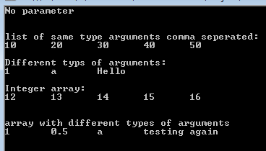
“Params” Keyword- Program3

Slide 99
Function Parameters
Que: How to pass value to method?
→ By using parameters to pass value to method.
Value Parameter (Call by value)(In parameter)
Output Parameter
Reference Parameter

Slide 100
Value Parameter (Call by value)(In parameter)
Allows a method to assign values to value parameter through arguments given in method call.
This type of assignment affects only local storage.
It has no affect on actual arguments being assigned in method call.
Default parameter

Slide 101

Value Parameter (Call by value)(In parameter)- Program
using System;
namespace HelloProgram
{
class CallByValueParameter
{
static void add(int v)
{
v++;
}
static void Main()
{
int value = 10;
add(value);
Console.WriteLine(value);
Console.ReadKey(); } } }

Slide 102
Output Parameter
Out parameter can be used to return values in same variable declared as method parameter.
Represents same storage location instead of creating new storage.
Declare with out modifier.
Every output parameter of method must be assigned before the method return the output.
It used in methods that produce multiple return value.

Slide 103

Output Parameter-Program-1
using System;
namespace HelloProgram {
class OutParameter {
static void set_value(out int v)
{
v = 20;
}
static void Main()
{
int value;
set_value(out value); // method calling
Console.WriteLine(value);
Console.ReadKey(); } } }

Slide 104

Output Parameter-Program-2
using System;
namespace HelloProgram{
class OutParameter
{
static void value(out int i,out string s1, out string s2)
{
i =20;
s1 ="Hello";
s2 = null;
}
static void Main()
{
int v;
string str1, str2;
value(out v, out str1, out str2); // method calling
Console.WriteLine(v + " " + str1 + " " + str2 );
Console.ReadKey(); } } }

Slide 105
Reference Parameter-Program
It is similar to out keyword but ref requires that the variable be initialized before being passed.
Gives error when used unassigned local variable value.
This method copies the reference to the memory location of an argument into the formal parameter. This means that changes made to the parameter affect the argument.

Slide 106
Reference Parameter-Program
using System;
namespace HelloProgram
{
class ReferenceParameter
{
static void set_value(ref int v)
{
v = 20;
}
static void Main()
{
int value = 10;
set_value(ref value); // method calling
Console.WriteLine(value);
Console.ReadKey(); } } }

Slide 107
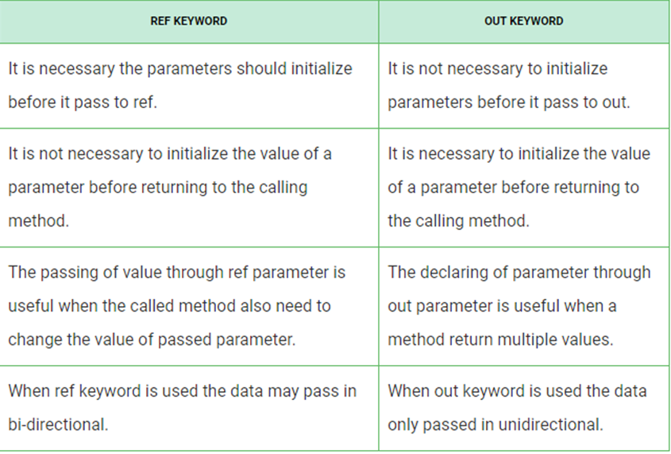

Slide 108
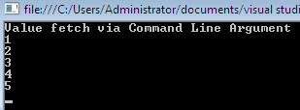
Command Line Argument-Program-1
using System;
namespace HelloProgram{
class CommandLineArgument{
static void Main(string[] args)
{
Console.WriteLine("Value fetch via Command Line Argument");
for (int i = 0; i < args.Length; i++)
{
Console.WriteLine(Convert.ToString(args[i]));
}
Console.ReadKey(); } } }

Slide 109

Cosmmand Line Argument-Program-2
using System;
namespace HelloProgram
{
class CommandLineArgument
{
static void Main(string[] args)
{
Console.WriteLine("Number of command line parameters = {0}", args.Length);
for (int i = 0; i < args.Length; i++)
{
Console.WriteLine("Arg[{0}] = {1}", i, args[i]);
}
Console.ReadKey();
}
}
}

Slide 110
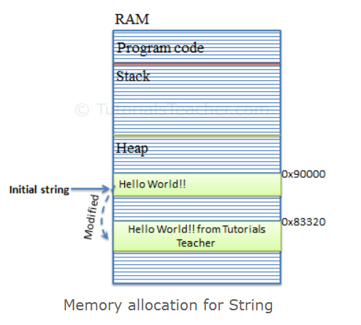
String
String are immutable.
Can’t Change a string after created it.
New memory copies will be created rather than going and updating the same one.

Slide 111

String
string a, b;
a = "Hello";
b = "How R U!!!!!!!!";
string temp = a + b; // string concat
string combine=string.Concat(a,b);
Console.WriteLine("The message is of temp is : {0}", temp);
Console.WriteLine("The message is: {0}",combine);
//constructor
char[] ch = { 'H', 'E', 'L', 'L', 'O' };
string letters = new string(ch); Console.WriteLine("Letter{0}",letters);
//returning string
string[] arr = { "Hello","How","R","U","!!!!!!" };
string message = string.Join(" ", arr); Console.WriteLine("message{0}", message);
//formatting methos to convert a value
DateTime waiting = new DateTime(2012, 10, 10, 17, 58, 1);
string chat = string.Format("message send at {0:t} on {0:D}", waiting);
Console.WriteLine("Message:{0}", chat);
Console.ReadKey(); } } }

Slide 112
String
string S=“Hello World”
Now replace string S with “Welcome”
In heap Hello World and new object of Welcome is created.
To solve this problem C#, introduced StringBuilder.

Slide 113
StringBuilder
StringBuilder is mutable, means if create string builder object then you can perform any operation like insert, replace or append without creating new instance for every time.
it will update string at one place in memory doesn’t create new space in memory.

Slide 114
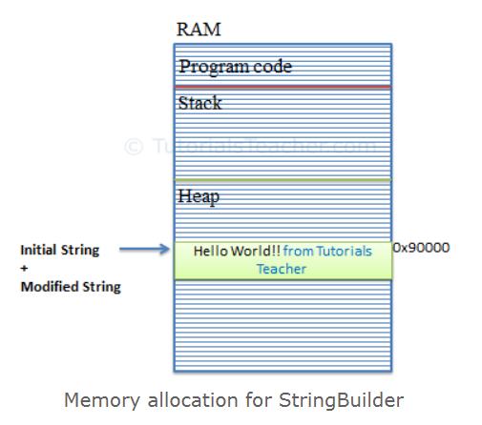
StringBuilder
StringBuilder is mutable, means if create string builder object then you can perform any operation like insert, replace or append without creating new instance for every time.
It will update string at one place in memory doesn’t create new space in memory.
StringBuilder sb = new StringBuilder()

Slide 115
String and StringBuilder
string a = "Hello";
a = a.Replace("o", "m");
Console.WriteLine(a);
string a = "Hello";
StringBuilder sb = new StringBuilder(a);
a = sb.Replace("o", "m");
Console.WriteLine(a);

Slide 116
StringBuilder Methods
sb.Append(value)
sb.Insert(index,value)
sb.Replce(old value, new value)
sb.Remove(starting index, length)
sb.Tostring()
Indexer

Slide 117
StringBuilder Methods
StringBuilder as Indexer
Use: To get or set a character at specified index
Example:
StringBuilder sb = new StringBuilder("Hello World!!");
for(int i=0; i< sb.Length; i++)
Console.Write(sb[i]);

Slide 118
Questions and Comments
???
Notes:
Faculty Notes:
Ask participants if they have any questions about the content covered in this presentation.

